Slide 1


Working with Documentation
http://academy.telerik.com
Writing Styles
Tina Stancheva
Enterprise Support Officer
Team X2
Telerik Software Academy
academy.telerik.com

Slide 2

Table of Contents
Getting Started
Good Practices
Use Sections
Use Bulleted Lists and Tables
Visualize the information
Logically structure the information

Slide 3
Getting Started
Choose a title
Describing the content
Describing the purpose of the tutorial
Use as few words as possible
Write an introduction
A few sentences to summarize
Telerik RadTreeView provides check boxes/radio buttons displayed next to each item. The RadTreeView allows the user to check/uncheck the nodes and to perform various tasks with the collection of checked nodes. Using the corresponding events, you can entirely handle the node-check action.

Slide 4
Good Practices
Write clearly
Short informative sentences in active voice.
Use consistent terminology, tone, and style
Avoid mixing different tones (friendly or less so)
Structure each content page
Clear, well-located headings
Short readable paragraphs.

Slide 5
Use Sections
Group related information and functions
Wrap them in sections
Headers should summarize text below
To make text easy for scanning
Example:
Using RadEditor in ASP.NET MVC
Getting the content of RadEditor
Setting the content of RadEditor

Slide 6
Use Bulleted Lists
Consider using bulleted lists to describe the properties and events of a control.
The following properties are related to the minimize feature:
• IsMinimizable - use this property to enable/disable the minimization functionality of the RibbonView. The default value is True.
• IsMinimized - use this property to set or get the current minimize state of the RibbonView.
• IsMinimizedPopupOpen - use this property to get whether the minimized popup menu of the RibbonView is opened or not.

Slide 7
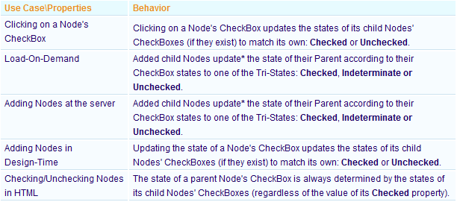
Use Tables
Consider using tables to describe the properties and events of a control:

Slide 8
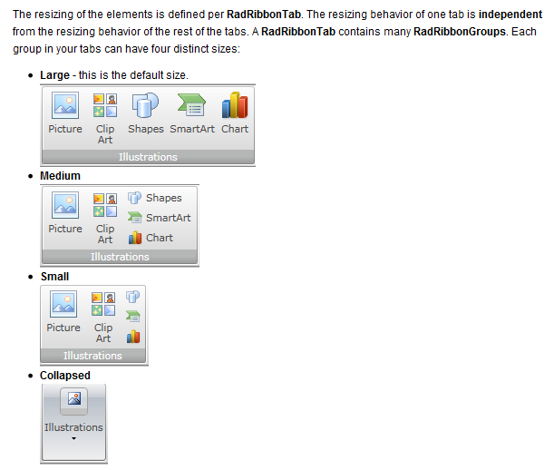
Visualize the information
Use images, graphs, charts where they might convey complex information more quickly:

Slide 9
Logically structure the information
List sample, logically ordered steps for the readers to follow:
In order to create a custom mask token, you need to define a new class that should implement the ITokenValidationRule interface.
…
Then you can start configuring the custom token through the following properties:
…
When you define the properties that describe the custom token, you need to implement a logic that controls whether the entered character is valid for that custom token
…
Finally the custom token will have the following definition:

Slide 10

Use a friendly tone
If you need to perform additional actions on uploaded files before saving them (for example, if you are using custom fields), or if you want to manipulate them in memory without saving them,
you can use the RadUpload server-side API. You can use the server-side API to rename uploaded files or save them into a database, or other storage medium.

Slide 11
Ask questions and provide answers
"I need each bar in a bar chart to be a different color. How do I do this?“
- By default RadChart is designed so that all bars from a series have the same colors. If you need each to have a different color, loop through each chart series item and assign them a color from an array. This should be done after binding the chart, so the chart series items are available.

Slide 12
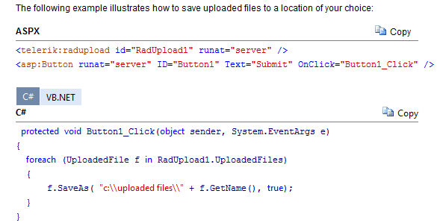
Describe the information with a code snippet

Slide 13

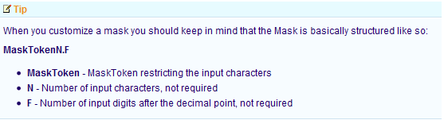
Use note-like sections
Use note-like sections within the topics to draw attention to important information

Slide 14
Documentation Writing Style
http://academy.telerik.com

